Slide 1

BLUETOOTH CONTROLLED FLOOR CLEANING ROBOT
TEAM MEMBERS
MEGHANA S
CHANDANA K B
MRUDULA N
SHREYA B RAJ
NLPE_029

Slide 2
NLPE_029
PRESENTATION OUTLINE
Related Works
Problem Formulation And Proposal
Design
Results
Introduction
Demo
Conclusion
Future Work
References

Slide 3
NLPE_029
INTRODUCTION
Bluetooth controlled robot is an Arduino based project.This is a semi autonomous robot car that cleans floors using water.The main purpose of this project is to ease our cleaning job.
OBJECTIVES OF THE PROJECT
It saves time.
It reduces man power.
To develop efficient low power consumption system.
It can reach the places the where people cannot go like under the table, sofa, bed etc.
To automate the job of cleaning

Slide 4
NLPE_029
RELATED WORKS
In this robot, we have used Arduino uno microcontroller. Instead of this other microcontrollers can also be used.
We can use brush in front part of the robot which can be used like a broomstick.

Slide 5
NLPE_029
PROBLEM FORMULATION AND PROPOSAL
For the earlier problems scientists invented “Vacuum Cleaner”. Using this cleaner, people are facing some problems like it is heavy to lift, machine that is often hard to move in the home.
Vacuum cleaner was manufactured in large size.
To solve the above mentioned problems, a cleaning robot is designed and developed which is fast and it can reach the places where people cannot go.
Basic goal of the project is to design a robot which decrease the effort of a person in scrubbing and sweeping and find solution to overcome drawbacks of the earlier cleaning techniques.
It is operated through mobile via Bluetooth control.

Slide 6
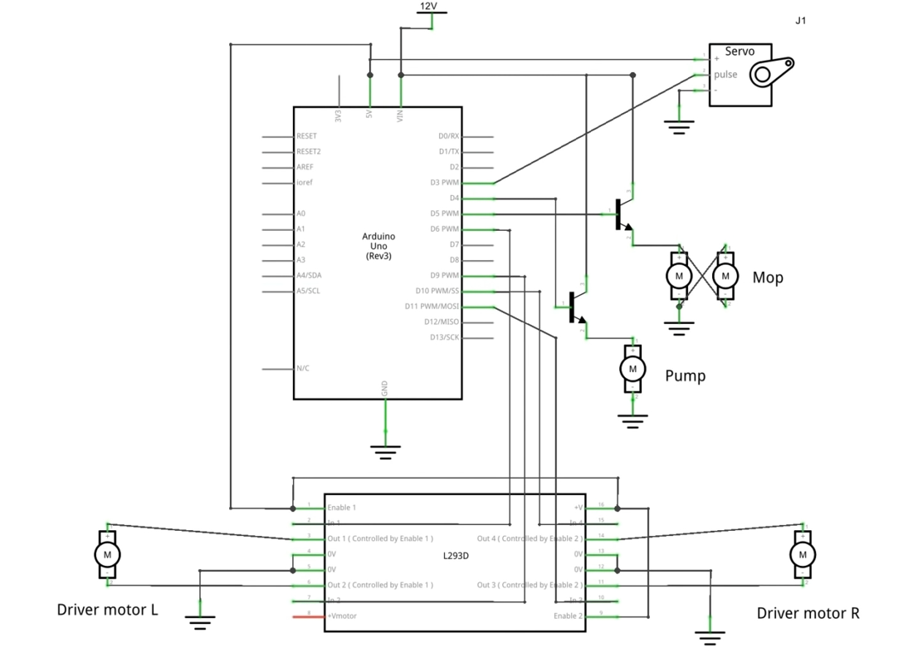
NLPE_029
DESIGN

Slide 7
NLPE_029
Clean Sweep is a smartphone controlled robot that cleans your house floor.
The rotating mops on the front of the robot can do the job perfectly.
There's also a water pump and water reservoir which can be switched on when required to spill water on the floor and make the mops moist for a proper clean.
There is also speed controllers for the driver motors.
The project uses bluetooth communication via an HC-05 bluetooth module to send the commands to Arduino UNO.
The robot is powered on a 12V lead acid battery, the ideal voltage for all motors used here.
The driver motor pair are 100rpm ones while for the mops I've used 75rpm plastic ones.

Slide 8
NLPE_029
RESULTS
This robot is very user friendly.
Price of this robot is very less compared to other cleaning technics it is mainly helpful for physically handicapped people where the person cannot move from one place to another place.
The robot cleans the house's floor by rotating mops along with servo motor.
There's also water pump and water reservoir which can be switched on when required to throw water on the floor and make the mops moist for a proper clean.
Power utilization is less by using this robot.

Slide 9
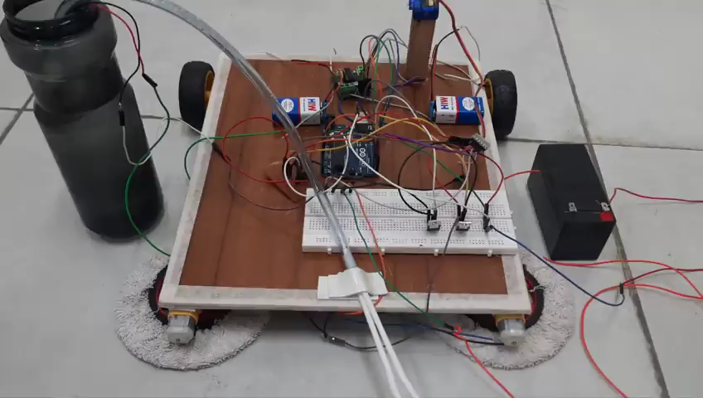
NLPE_029
PROJECT DEMO

Slide 10
NLPE_029
CONCLUSION
This project facilitates effective floor cleaning with mopping operations. It reduces the labour cost and saves time also and provides efficiency.
This robot is designed in such way that it can be used in house, offices. By using this Robot we can mop easily. It is operated through mobile via Bluetooth control.
Overall, this robot is very much necessary for modern days busy lifestyles.

Slide 11
NLPE_029
FUTURE WORK
In this project we are controlling the robot using Bluetooth module through our smart phones.
But this can be improvised in the following ways:
We can use ultrasonic sensors to sense the obstacles so that the robot can move on its own.
If the ultrasonic sensors sense any obstacles, it can be notified with some beep sound or by blinking of led.
We can use sound sensors to give commands to the robot, according to which the robot can move.
The wet mops can be dried using some sophisticated squeezers.

Slide 12
NLPE_029
REFERENCES:
➢ Uman Khalid, Haseeb Haider, Tahseen Amin Khan Qasuria “ Smart Floor Cleaning Robot (CLEAR)” in IEEE standard 2015. 6.
➢ Naman Aggrawal, Piyusha Chaudhari, Akshay Mahalkar “Review Paper Based on Cleaning Robot”, vol.3 No.5 May 2016.
➢ https://youtube.com/playlist?list=PLV3C-t_tgjGFyXP_-AF37AoIuxM9jzELM
➢ https://www.electronicshub.org
https://docs.arduino.cc/learn/electronics/servo-motors

Slide 13
NLPE_029
THANK YOU

